Slide 1

An overview of python
Introduction to python
Getting started & working with data
UMid all hands F2F, Madison, WI
September 27th, 2023
Photo: Samuel Li
https://www.old.channel3000.com/content/uploads/2021/03/608-samuel-li.jpg

Slide 2
Motivations for using Python
Automate tedious, boring and repetitive tasks (and manage cognitive load)
Escape limits imposed by other people’s software
Improve quality and efficiency of work
Scientific reproducibility
See also this recent debate about GUIs vs scripting https://gmdsi.org/blog/gmdsi-tech-talk-scripted-workflows-vs-guis/
Notes:
Really these are motivations for scripting; we talk about python specifically in a few slides.
Any important (and often less discussed) point of the GMDSI debate is the quality of life benefit.

Slide 3
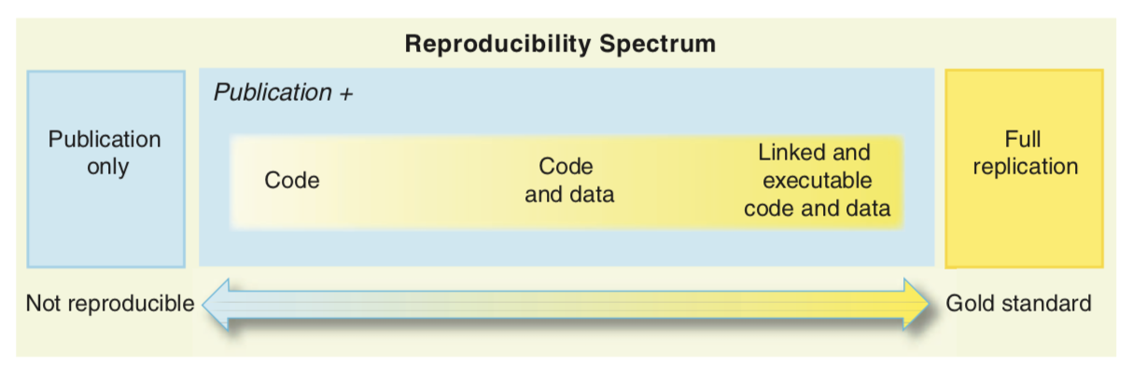
Python and Reproducibility
Peng, R.D. 2011. Reproducible Research in Computational Science, Science 334, p 1226-1227
Hutton, C., T. Wagener, J. Freer, D. Han, C. Duffy, and B. Arheimer (2016), Most computational hydrology is not reproducible, so is it really science?, Water R. Res., 52, 7548–7555, doi:10.1002/2016WR019285.
Ince, D.C., Hatton, L., Graham-Cumming, J., 2012, The case for open computer programs, Nature 482, p 485-488.
Notes:
Full replication is still very difficult, but Python can help us move further along the reproducibility spectrum.

Slide 4
Python and Reproducibility
John Claerbout, an earth scientist at Stanford, [was] … paraphrased in Buckheit and Donoho (1995): “an article about computational result is advertising, not scholarship. The actual scholarship is the full software environment, code and data, that produced the result.”

Slide 5
What is Python?
Interpreted, high-level language for general-purpose programming
Based on C
Object-oriented
Highly extensible
Besides standard library, large ”ecosystem” of packages for diverse purposes
Emphasizes code readability, simplicity and flexibility
Guido van Rossum
Notes:
...In December 1989, I was looking for a "hobby" programming project that would keep me occupied during the week around Christmas. My office ... would be closed, but I had a home computer, and not much else on my hands. I decided to write an interpreter for the new scripting language I had been thinking about lately: a descendant of ABC that would appeal to Unix/C hackers. I chose Python as a working title for the project, being in a slightly irreverent mood (and a big fan of Monty Python's Flying Circus).
— Guido van Rossum

Slide 6
What does it mean to be pythonic?
Some of the core principals:
Beautiful is better than ugly
Explicit is better than implicit
Simple is better than complex
Complex is better than complicated
Readability counts
https://en.wikipedia.org/wiki/Zen_of_Python
Notes:
...In December 1989, I was looking for a "hobby" programming project that would keep me occupied during the week around Christmas. My office ... would be closed, but I had a home computer, and not much else on my hands. I decided to write an interpreter for the new scripting language I had been thinking about lately: a descendant of ABC that would appeal to Unix/C hackers. I chose Python as a working title for the project, being in a slightly irreverent mood (and a big fan of Monty Python's Flying Circus).
— Guido van Rossum

Slide 7
Advantages
Ease of programming
Well designed language
Modular and object-oriented
Documentation is in the code
Large standard library
Larger collection of add-on packages
Platform-independent
Popular (now the #1 language)
Free!

Slide 8
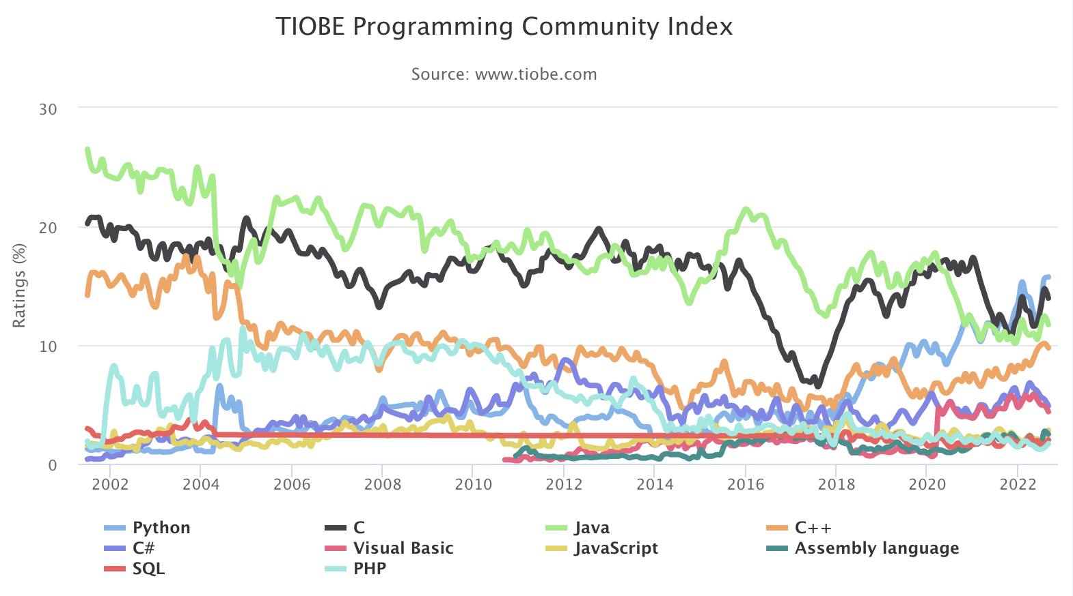
TIOBE Index (September 2022)
https://www.tiobe.com/tiobe-index/
Notes:
The TIOBE Programming Community index is an indicator of the popularity of programming languages. The index is updated once a month. The ratings are based on the number of skilled engineers world-wide, courses and third party vendors. Popular search engines such as Google, Bing, Yahoo!, Wikipedia, Amazon, YouTube and Baidu are used to calculate the ratings. It is important to note that the TIOBE index is not about the best programming language or the language in which most lines of code have been written.
Python has moved from third to first since the last time we taught this class (in November, 2018 in Madison, WI)

Slide 9
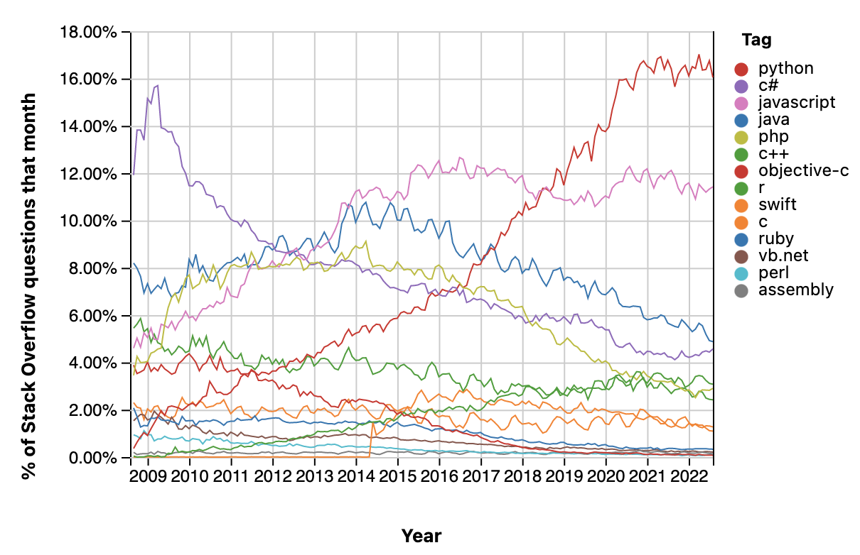
Stack Overflow Questions by language
https://insights.stackoverflow.com/trends
Notes:
Based on this blog post: https://blog.pythonanywhere.com/67/, and the graph above, total number of users worldwide might be around 10 million as of 2018.

Slide 10
Disadvantages
Can be slower than other languages
Somewhat decentralized
Changes frequently
Installation/Hard to get started
Easy to write bad code
https://towardsdatascience.com/5-reasons-why-jupyter-notebooks-suck-4dc201e27086
Notes:
If you’re new to scripting, learning Python can require some time.
And you get what you put in. The better you know Python, the more you can do, and the faster you can do it with less effort.

Slide 11
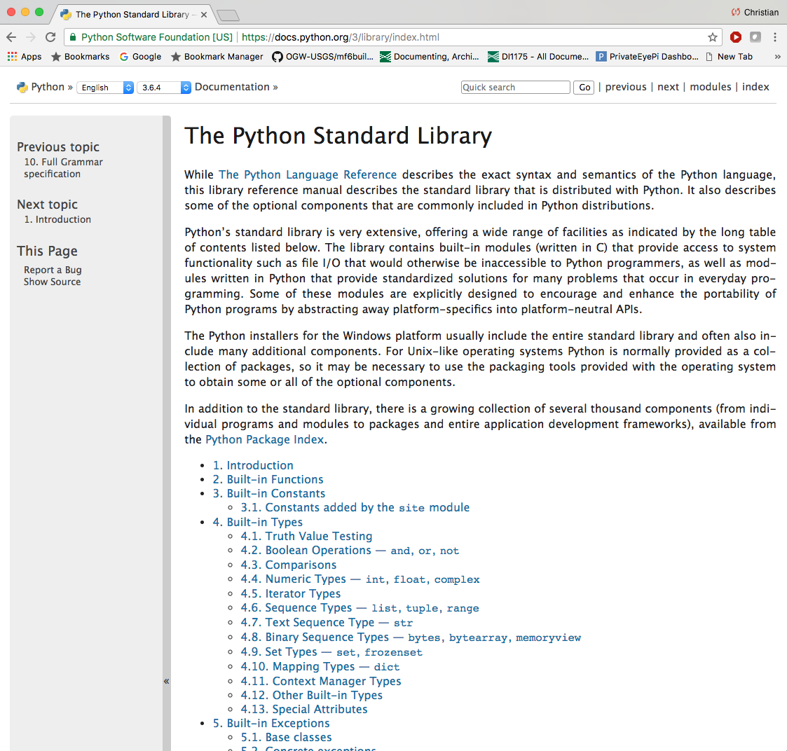
Python Standard Library
Notes:
Maintained by the Python Software Foundation
Includes many packages (pathlib, os, shutil, zipfile, etc)

Slide 12
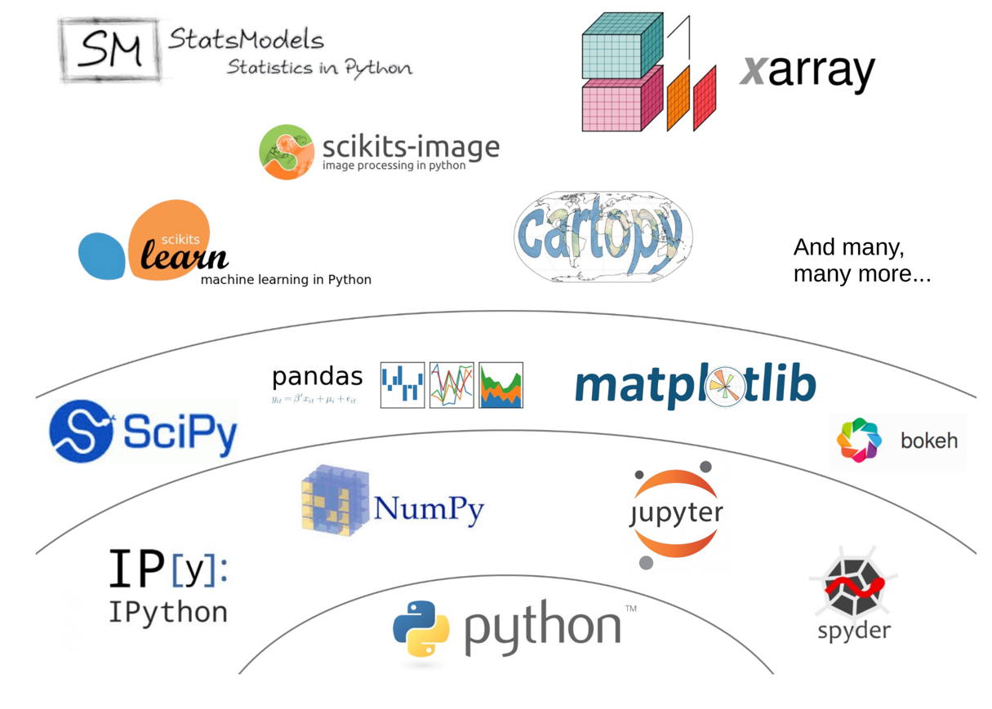
Python's scientific ecosystem
https://fabienmaussion.info/scientific_programming/week_05/02-Scientific-Python.html
Notes:
Unlike Matlab, the set of Python tools used by scientists does not come from one single source. It is the result of a non-coordinated, chaotic and creative development process originating from a community of volunteers and professionals.

Slide 13
Development Environments
Python interpreter
Ipython
Jupyter Notebook or Jupyter Lab
Best for data exploration, demonstrations, works in progress, simple one-off code, etc.
IDE (integrated development environment) such as VS Code
Best option for developing “production” or “operational” code- anything you want to re-use!
Notes:
Key benefits of Jupyter notebook are non-linear execution, and embedded plots and annotations
Non-linear workflow is also key disadvantage- easy to write code that doesn’t work
No linting
No debugging
Hard to re-use code
Some people also use Spyder, which has a Matlab-like feel, and is interactive, but without any of the reproducibility aspects of Jupyter Notebooks

Slide 14
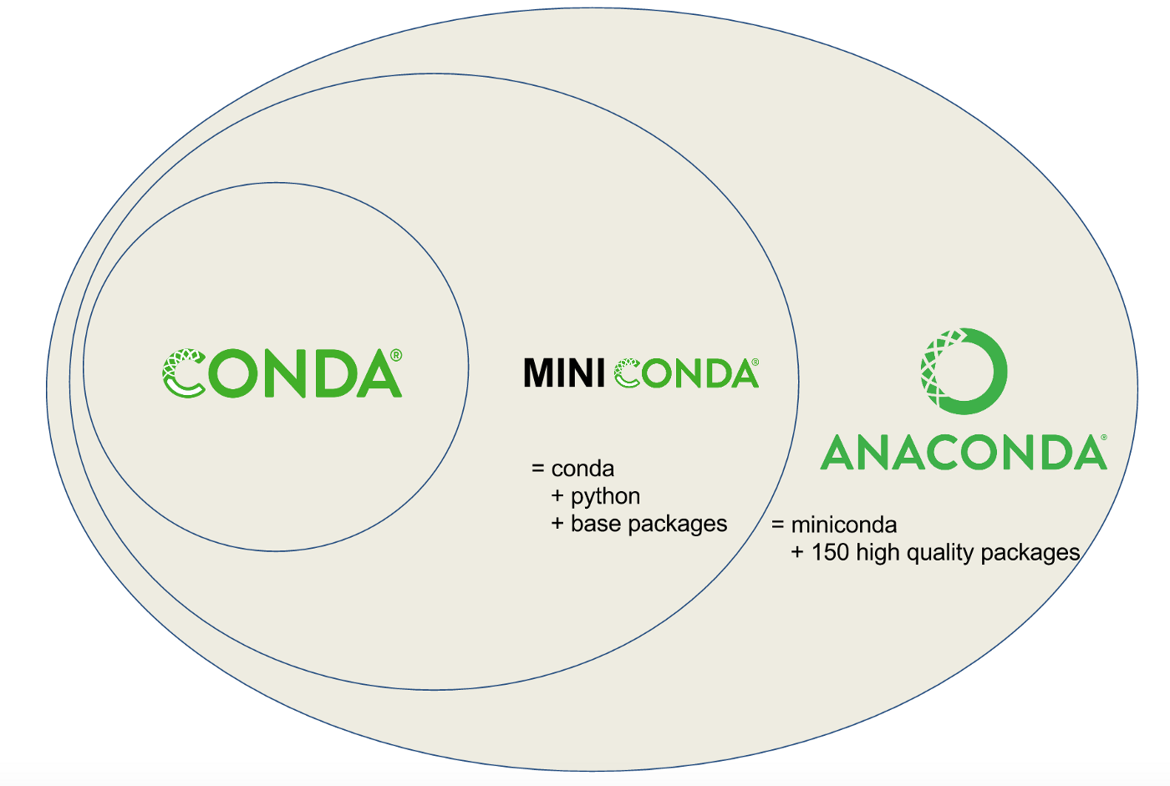
Python Distributions
A bundled collection of Python and many of the useful packages
There are several flavors
Anaconda/Miniconda
Python.org
Your system python
ArcGIS or QGIS python
etc
https://towardsdatascience.com/managing-project-specific-environments-with-conda-b8b50aa8be0e
Notes:
Also used to be Enthought Canopy, Python x,y, etc.

Slide 15
Python Versions
Python 2 has been retired
We are using Python 3.9 for the class

Slide 16
Resources for “best practices”
PEP8 python style guide: https://www.python.org/dev/peps/pep-0008/
Numpy doc string format: https://numpydoc.readthedocs.io/en/latest/format.html
”Good enough” practices for scientific computing: https://swcarpentry.github.io/good-enough-practices-in-scientific-computing/
Resources for packaging, testing, documenting, and publishing scientific Python code:
pyOpenSci org: https://www.pyopensci.org/resources/
The Scientific Python Cookiecutter https://nsls-ii.github.io/scientific-python-cookiecutter/index.html
Notes:
Your biggest collaborator may be your future self (6 months from now). If nothing else, following best practices helps them. Beyond that, following best practices can help others understand your code and not only reproduce your work, but potentially improve their work as well. They may even want to contribute back to your project.
Best practices make open-source collaboration possible, and the relatively small groundwater modeling community has benefited enormously from this system, which gives us access to high quality software that is developed and used by tens to hundreds of millions of people worldwide.

